Slide 1
JIMA — Technical Art & Lighting Optimization
“MegaLights is production-ready in UE 5.8 — many dynamic shadow-casting lights that used to be too expensive are now affordable. Relight a slice of JIMA so its lanterns, torches and the lantern-spirit cast real dynamic shadows, and lock a MegaLights + Lumen Lite profile that holds 60fps on PS5. The whole game is lantern-lit dread and the design worried about lighting cost — 5.8 removes that constraint.”

Slide 2
JIMA — Technical Art & Lighting Optimization
I am a Technical Artist Working on MegaLights, Lumen Lite, Hardware Ray Tracing within Unreal Engine 5.8
The target platform is PS5 with a locked FPS of 60

Slide 3
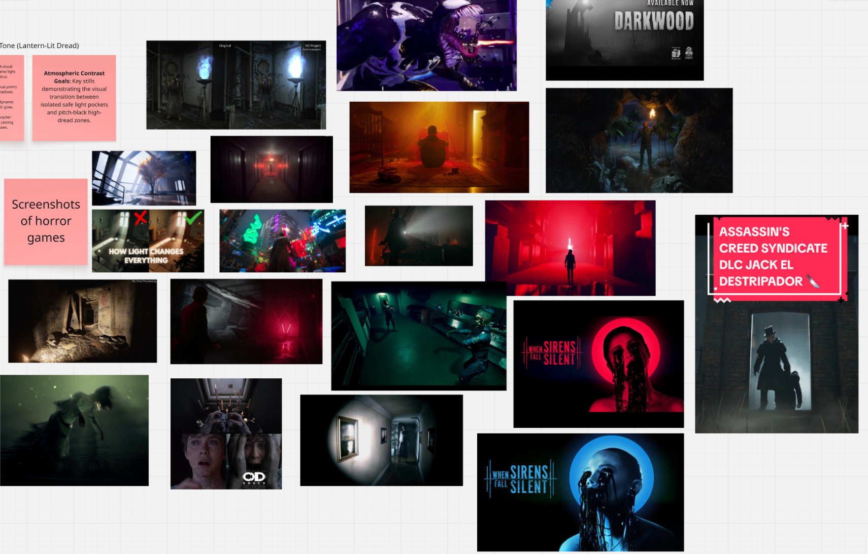
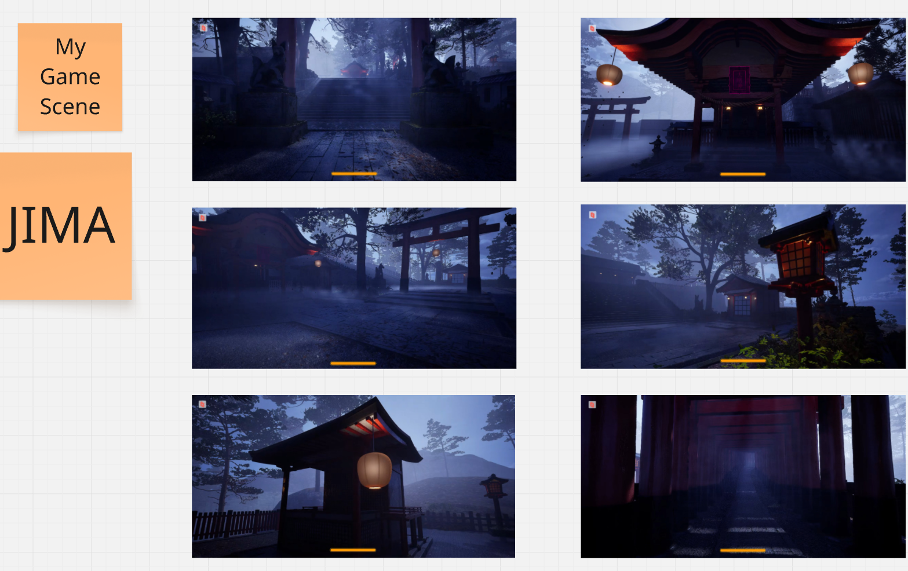
Here is some examples of horror lighting in games vs the level I worked on (At the start)

Slide 4
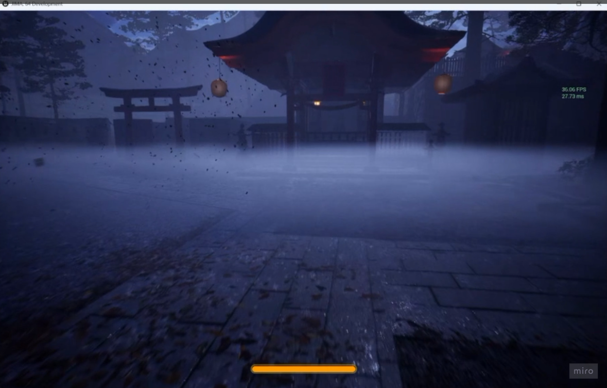
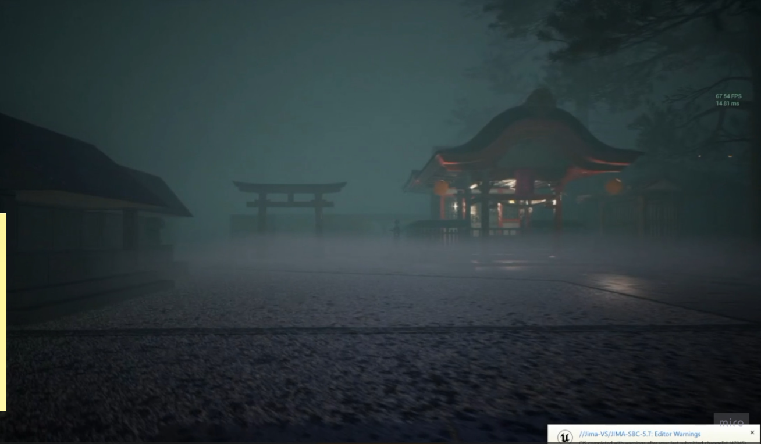
How it started vs how it looks now
Start of LOF0
End of LOF1

Slide 5
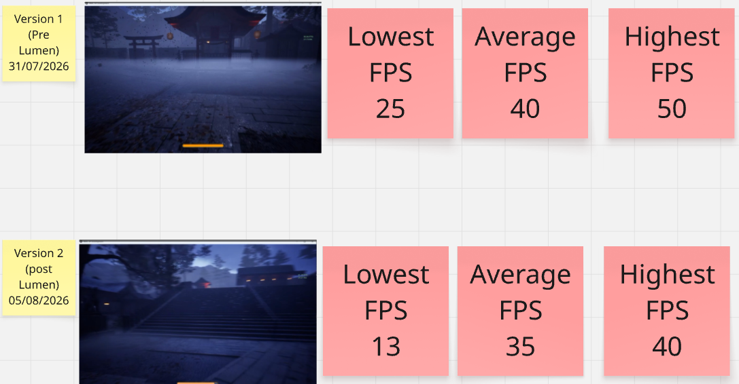
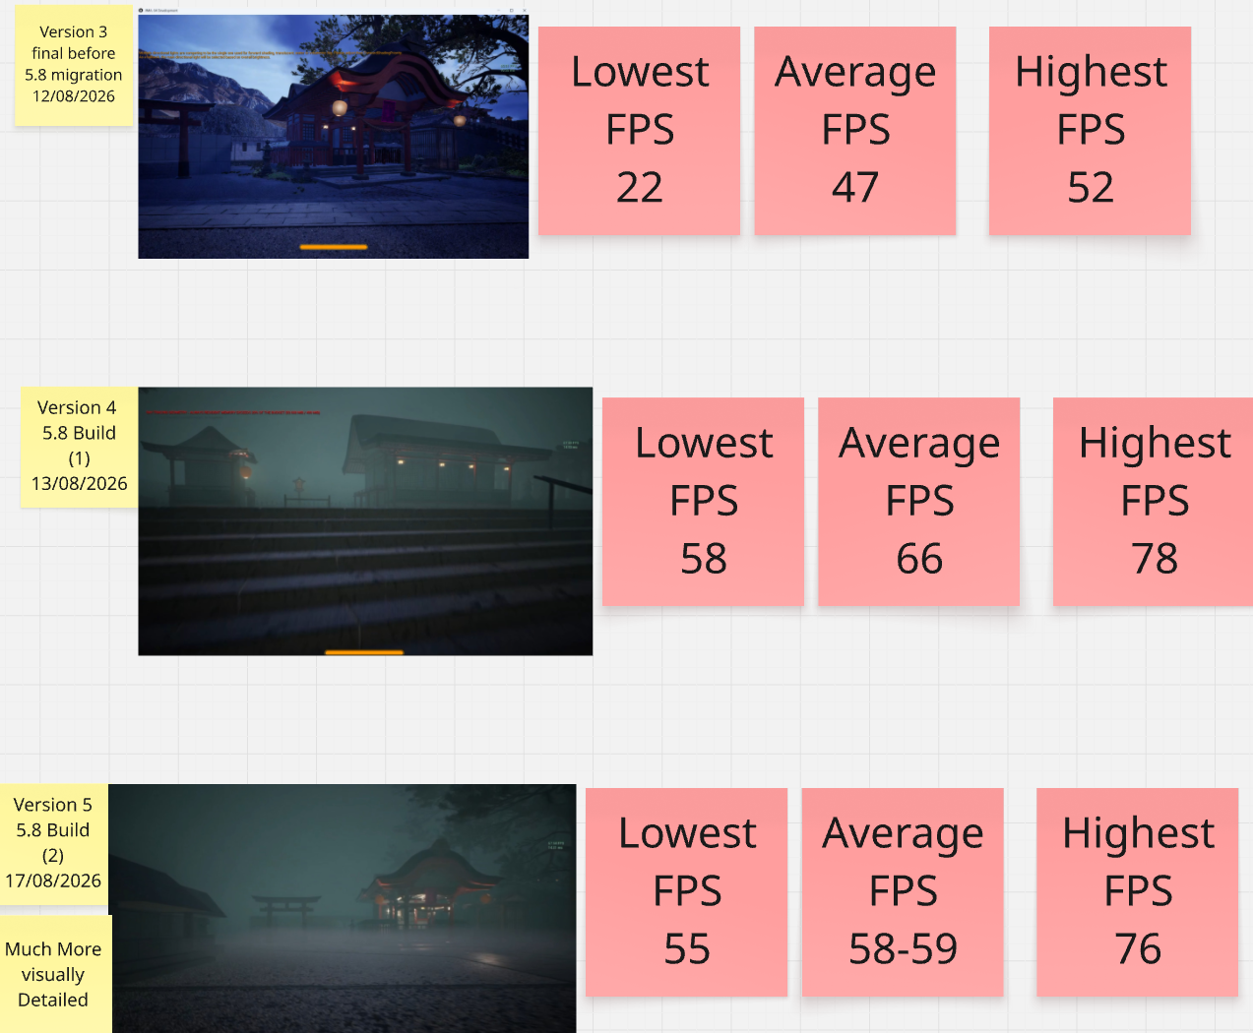
Frames between Versions

Slide 6
Hansoft Milestone Transition (LOF0 to LOF1):
What each card was for
LOF0 (Prototype and testing): Speed-focused vertical slice to prove whether MegaLights + Lumen Lite could run on development PCs/Parsec laptops.
LOF1 (5.8 version Internal Demo): Rigorous bug-fixing sprint targeting stability, eliminating the 5-minute memory drop, and packaging a duo of standalone builds (With the help of Dan).

Slide 7
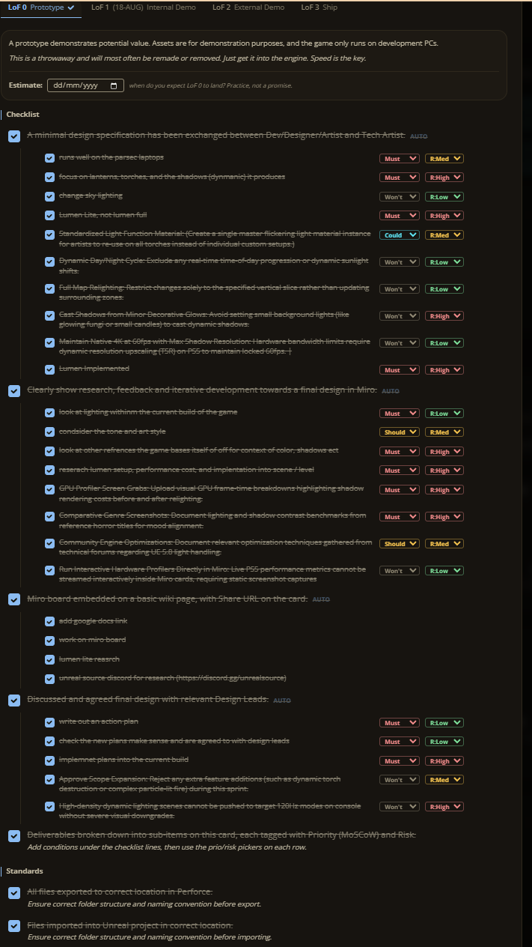
Handout Card LOF0

Slide 8
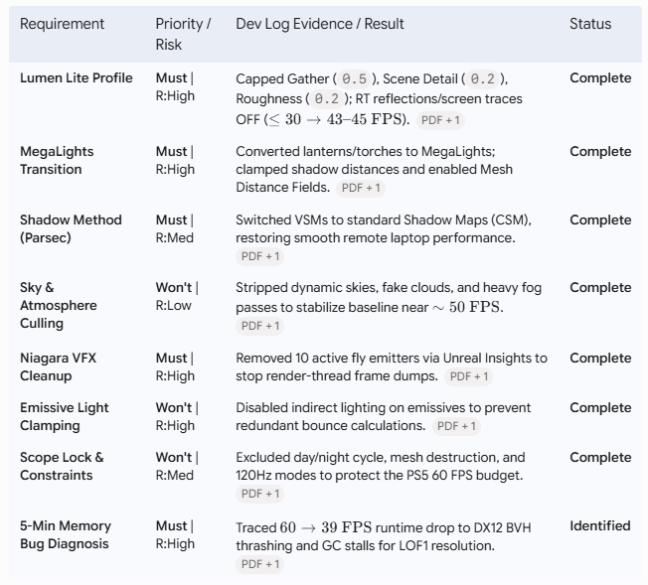
LOF0 Goals from Handoff and how they were done (For this section)

Slide 9
LOF0 Build Exact stats (At the end)
Stage / Iteration | Configuration Highlights | Frame Rate (FPS) | Stability / Observations
Baseline (Unoptimized) | Stock settings, Lumen disabled | 35 – 45 FPS | Baseline editor performance
Stock Lumen (Default) | Full Lumen & default VSM | ≤ 30 FPS | Severe GPU cost; unplayable
Initial RT Adjustments | Translucent reflections disabled, Shadow Maps instead of VSM | 27 – 35 FPS | Initial recovery step
Lumen Lite Pass 1 | Final Gather: 1.0, Reflections Threshold: 1.0 | 35 – 45 FPS | Peaks into the low 50s
Lumen Lite Pass 2 (Aggressive) | Final Gather: 0.5, Scene Detail: 0.2, Max Roughness: 0.2 | 40 – 45 FPS | Standalone highs of 52 FPS; occasional dips to 35 FPS
VFX & Atmosphere Culling | Removed 10 Niagara fly systems, dynamic skies & fog pass | ~44 – 50 FPS | Much tighter average; eliminated heavy particle hitches

Slide 10
Some Issues (LOF0)
The 5-Minute Degradation Bug (45 to sub 30 FPS):
The engine boots at 45 FPS before steadily degrading to sub-30 FPS over a 5-minute session. This progressive drop was present from the initial baseline prior to activating Lumen, pointing toward garbage collection stalls and cumulative memory/resource leaks rather than static shader complexity.
Niagara Particle Culling:
Unreal Insights profiling revealed that 10 concurrently active fly emitters were triggering severe frame-time spikes on the render thread, requiring their removal to stabilize performance.
Editor-Only Profiling Constraints:
Testing had to be conducted directly within the Unreal Editor due to the lack of a standalone/packaged development build, introducing editor overhead and background process noise to frame-time captures.

Slide 11
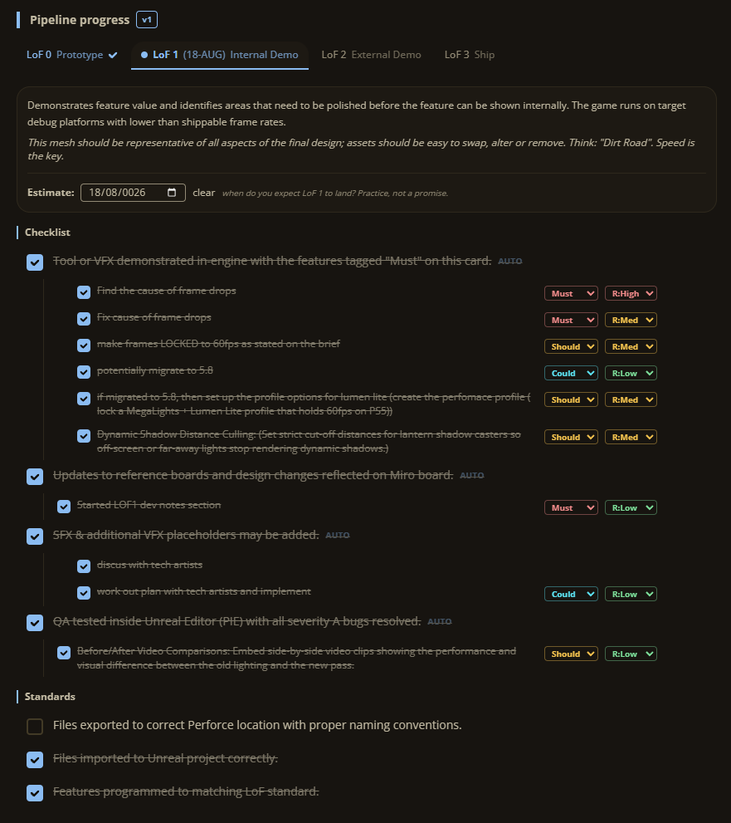
Handout Card LOF1

Slide 12
Requirement | Priority | Implementation / Evidence | Status
Find cause of frame drops | Must | R:High | Identified RT memory thrashing (406MB cap), shadow depth spikes (6.2ms), high draw calls (950+), and Niagara CPU stalls via stat GPU / Insights. | Complete
Fix cause of frame drops | Must | R:Med | Raised RT memory to 1024MB, clamped shadow distance to 20m, merged meshes into ISMs (<400 draws), disabled Path Tracing. | Complete
Lock 60 FPS target | Should | R:Med | Locked 60 FPS (16.6ms) in corridors; courtyard stabilized at 54–56 FPS (58–62 FPS avg) via shadow culling + ISM batching. | Validated
Migrate to UE 5.8 | Could | R:Low | Upgraded to UE 5.8.1 for production-ready MegaLights, unified direct lighting passes, and Ray Tracing Proxies. | Complete
Configure Lumen Lite | Should | R:Med | Applied .ini profile: Final Gather 0.5, Scene Detail 0.2, Max Roughness 0.2, Screen Traces & RT Translucency OFF. | Complete
Dynamic Shadow Culling | Should | R:Med | Clamped master light Blueprints to 20m max shadow distance (5m fade) and 4.5m light function cutoff. | Complete

Slide 13
Issues with LOF1
Visual & Lighting Issues
Shadow Pop-In: Aggressive distance culling causes visible shadow popping in the courtyard.
Very Noisy at times: Multiple dynamic lights on the wet cobblestones created an ugly shimmering effect.
Performance & Memory Bottlenecks
Courtyard Light Overlap: 30+ overlapping light cones used to drop open-area frame rates to sub 50 frames (Semi fixed now)
RT Memory Thrashing: The default 406MB pool triggered DX12 BVH rebuild stalls and frame degradation (Fixed).
Garbage Collection Spikes: Engine GC sweeps cause intermittent 16.4CPU hitches (Still above locked 60 most of the time).
Pipeline & Standards
Perforce Handoff: Final .ini scalability and master light Blueprints differences due to the fact it's different versions
Not having the automatic builds created every night by perforce (Also not being on perforce due to being a different version to the rest of the project)

Slide 14
Show gameplay section

Slide 15
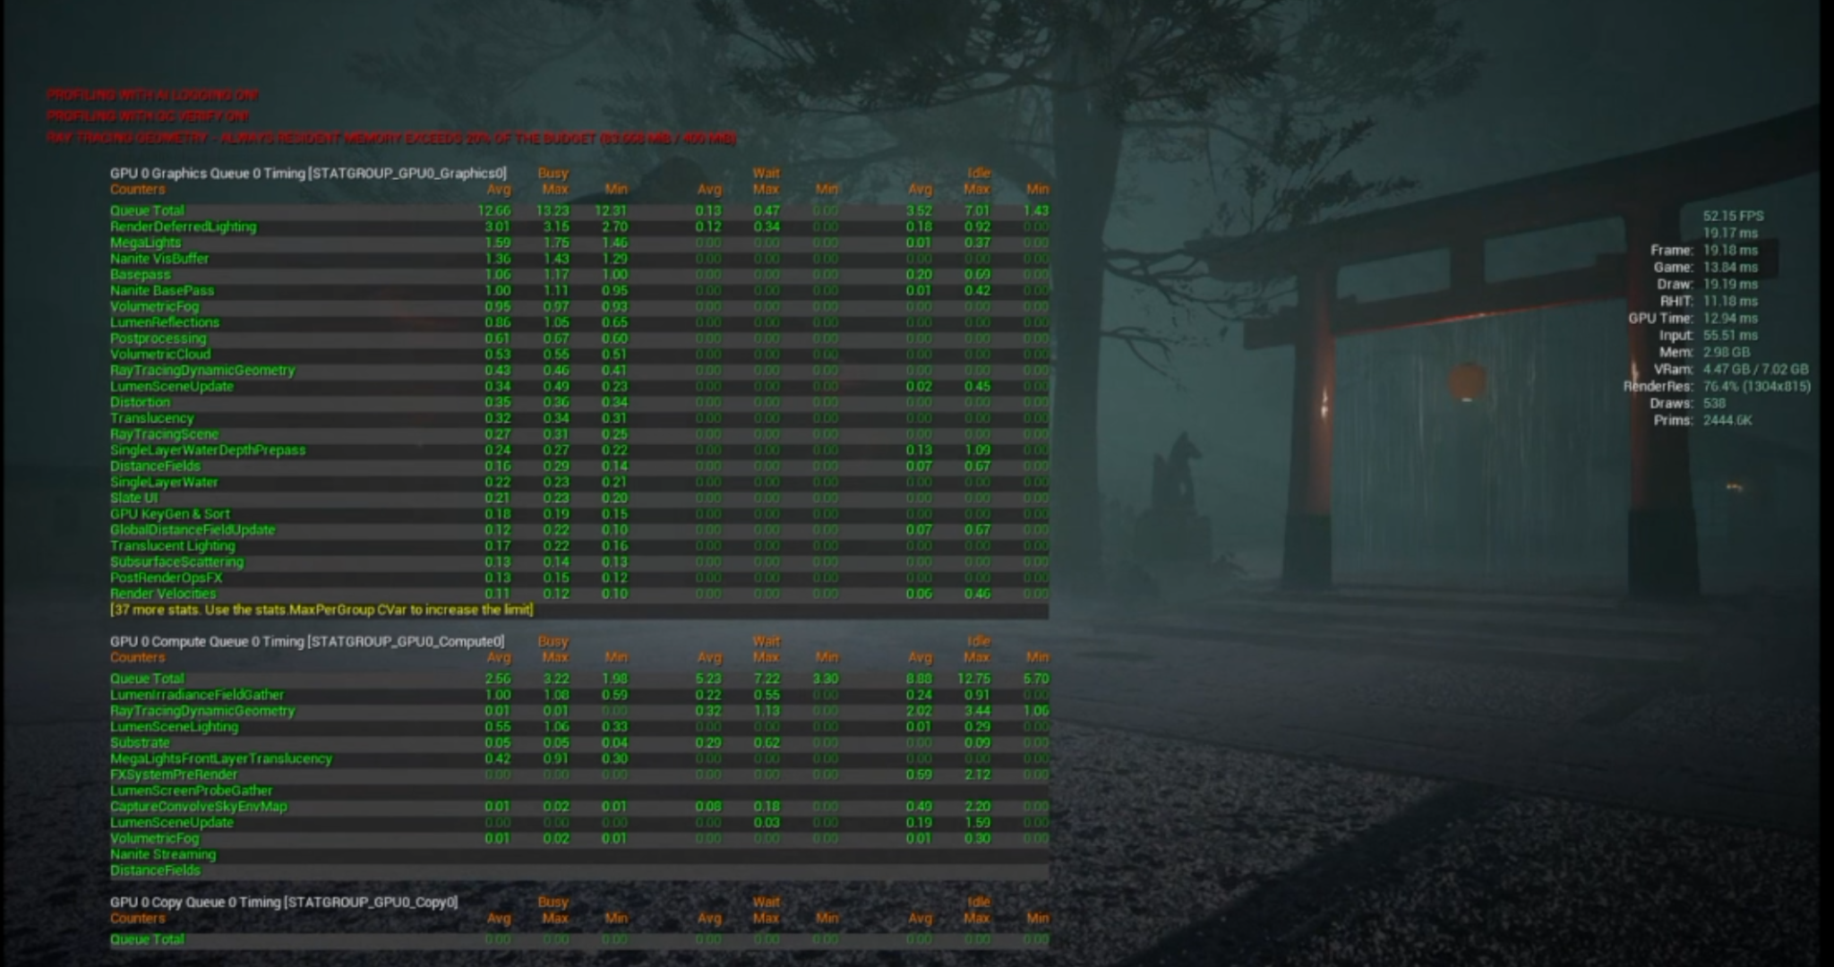
Gpu of build 1

Slide 16
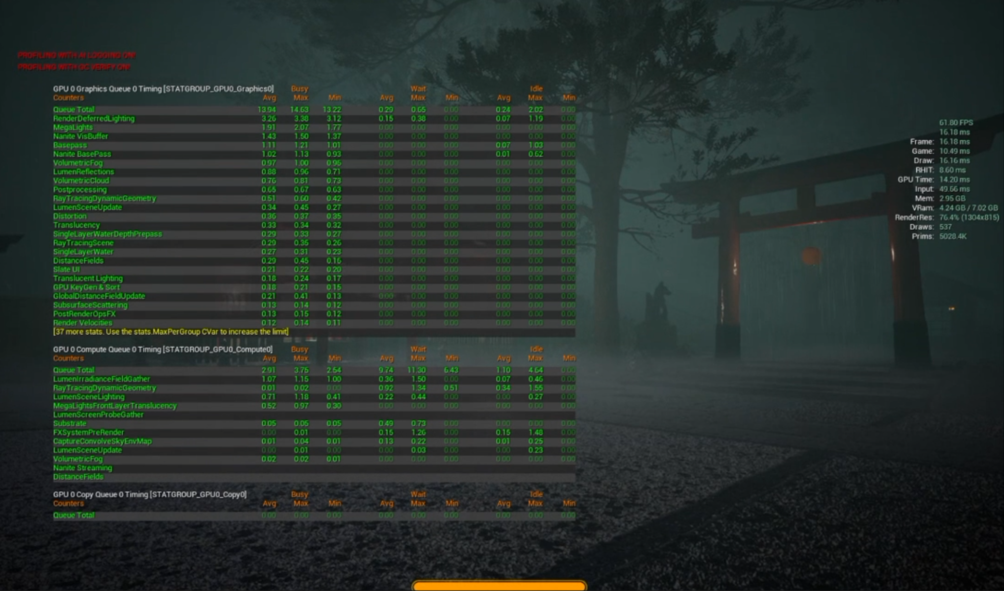
Gpu of build 2

Slide 17
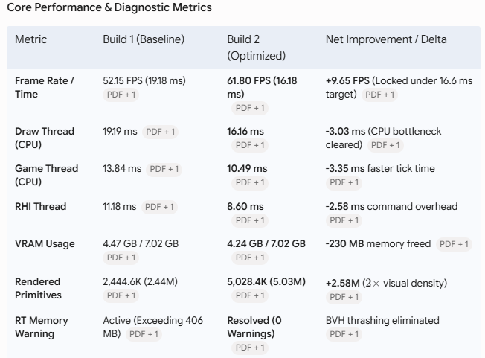
Gpu comparison of both builds
PS5 60 FPS Target Is Doable: Frame time dropped from 19.18 ms to 16.18 ms, surpassing the target 60 FPS (16.6 ms) ceiling (Although it isn't perfect (Yet).
CPU Thread Bottleneck Eliminated: Draw Thread dropped by 3.03 ms and Game Thread dropped by 3.35 ms, preventing CPU stalls before rendering passes reach the GPU.
Doubled Geometric Detail with Better Performance: Scene primitive count increased from 2.44M to 5.03M (+105% detail) while simultaneously running faster.
Memory Pool Expansion: VRAM dropped by 230 MB and the red Ray Tracing resident memory budget warning was completely cleared, preventing mid-game DX12 BVH thrashing and stutter.

Slide 18
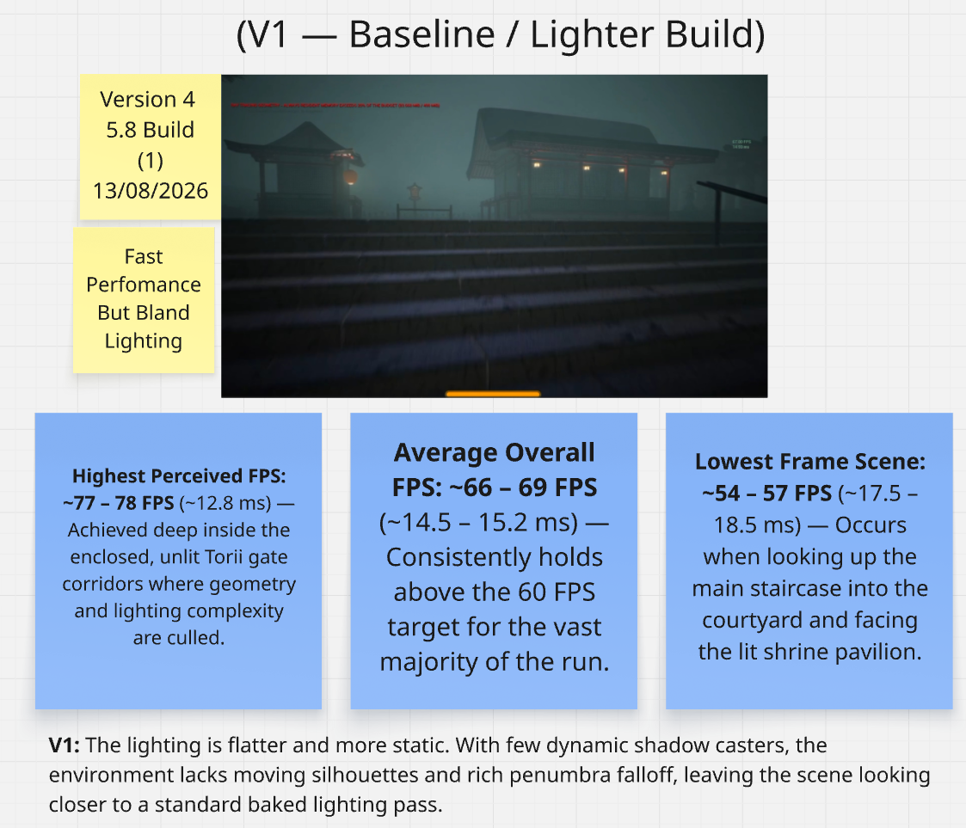
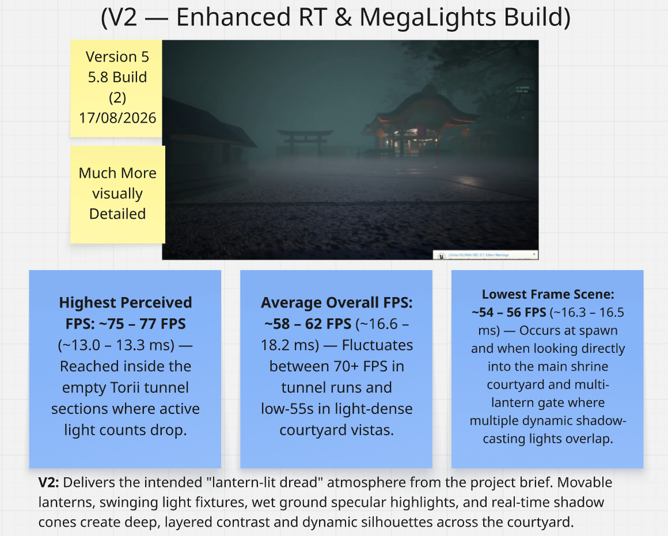
5.8 Builds V1 Vs V2

Slide 19
More stats
Key Visual & Design Upgrades
True Multi-Light Dynamic Shadowing:
Every hanging lantern, roadside brazier, and courtyard lamp in V2 casts real-time moving shadows, creating dense geometric silhouettes across stone fences and Torii gates that were completely absent in V1.
Hero Lantern-Spirit Integration:
V2 fully supports the moving lantern-spirit light source sweeping across the environment without requiring baked light fallbacks or disabling world shadows.
Environmental Wetness & Specular Response:
Stone steps and cobblestone pathways now feature real-time specular highlights from multiple light sources, elevating visual fidelity in dark courtyard areas.
Technical & Architecture Advances
MegaLights Use increased:
Replaces legacy per-light rasterized shadow map passes with unified stochastic ray-traced direct lighting, allowing multiple overlapping light cones in dense courtyard vistas.
Lumen Lite Optimization:
Switches global illumination evaluation to Surface Cache and Irradiance Fields, saving ~1.3 ms of GPU time compared to Full Lumen.
Hardware Ray Tracing Proxies:
V2 generates low-poly proxy representations for RT traversal, reducing BVH build times on high-density environment props.
Milestone Progress Toward 60 FPS (PS5 Budget)
Visual Benchmark Locked:
V2 establishes the agreed-upon art direction and lighting density required by the project brief.
Culling & Budget Alignment:
Applying a 20-meter shadow clamp, increasing the RT memory pool to 1024 MB, and instancing repetitive path meshes brings V2's visual density directly into a locked 16.6 ms (60 FPS) performance window.

Slide 20
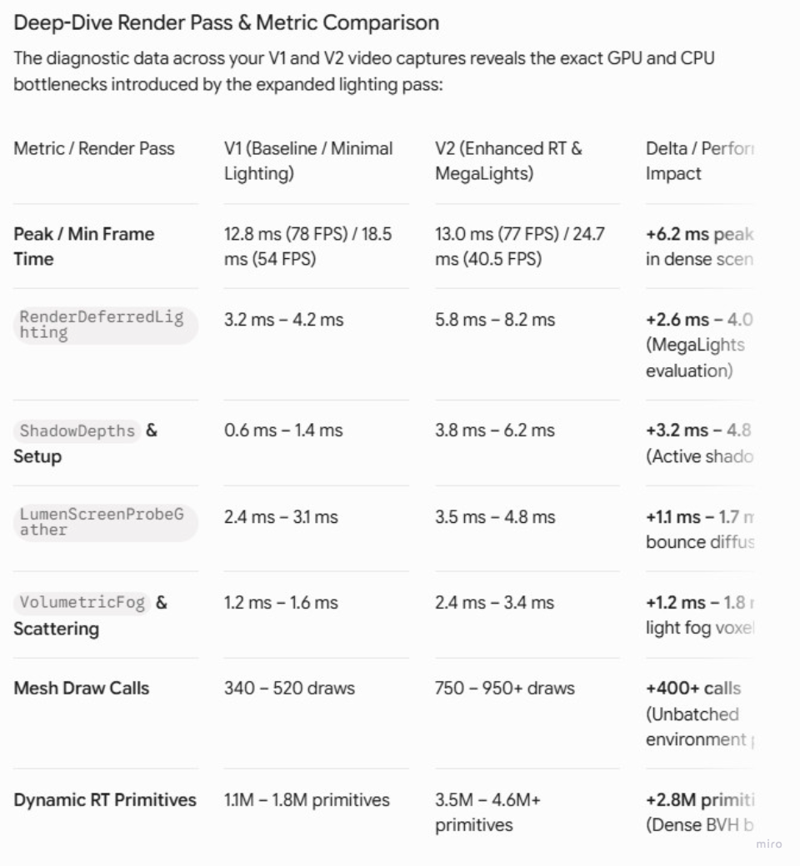
Hard Stats Between Builds

Slide 21
Do I think My Brief is possible, YES
Target & Baseline
The Goal:
Lock a stable 60 FPS (16.6 ms) for PS5 (hardware) without compromising visual fidelity or mood.
At this stage
The project averages 57–62 FPS globally on Maxed out (AKA Epic) settings (That remain unchanged after setting it to lumen lite) (These include but are not limited to Nanite geometry, MegaLights direct lighting, Texture quality & streaming and Niagara particle simulation
Dips into the 50s frames due to memory thrashing and uncapped passes, not hardware limits.
Key Bottlenecks & Fixes
RT Memory Budget: Expanded default 406 MB pool to 1024 MB, permanently resolving DX12 BVH rebuild stalls.
MegaLights Shadow Spikes: Clamped lantern shadow draw distance to 20 m (5 m fade), instantly recovering 2–3 ms of GPU time.
Lumen Lite on Global Epic: Kept geometry and direct lighting at Epic while capping probe gather (0.5) and roughness tracing (0.2)—saving ~1.5–2.0 ms of compute with zero loss to wet cobblestone specular fidelity.
Conclusion
The takeaway is that while Direct MegaLights and Nanite carry the heavy visual lifting (at our Epic quality setting), while trimming invisible Lumen overhead can bring the performance comfortably inside the 16.6 ms PS5 performance budget (and there are other things we can also lower outside of lumen settings to improve performance in the meantime.)

